Slide 1
Real Time Embedded Systems
Course code: CoSc3026/SEng4033
By- Dr. Mohammad Nasre Alam

Slide 2
Chapter 3
Software Frameworks for Real-time and Embedded Systems
Contents
Real-time Operating System
General and Specific microprocessors
Inter Process Communication
Real-time Task Scheduling
Dynamic Allocation of tasks
Multi-tasking and Concurrency issue
Handling Resource sharing and Task Dependencies
Faul-tolerance
Synchronization techniques

Slide 3
Real-time Operating System
Definitions
A Real-Time Operating System (RTOS) is an operating system for real-time applications that processes data and events that have critically defined time constraints.
Characteristics of a real-time operating system
Small footprint- Real-time operating systems are lightweight.
High Performance- RTOSes are typically fast and responsive.
Determinism – Ensures tasks are completed within a predictable time.
Safety and security – Safety-critical and security standards are typically the highest priority, as RTOSes are frequently used in critical systems.
Priority-based scheduling – Tasks that are assigned a high priority are executed first followed by lower-priority jobs.
Timing information – RTOSes are responsible for timing and providing application programming interface.
Basic Functions of RTOS
Task Management
Scheduling
Resource Allocation
Interrupt Handling

Slide 4
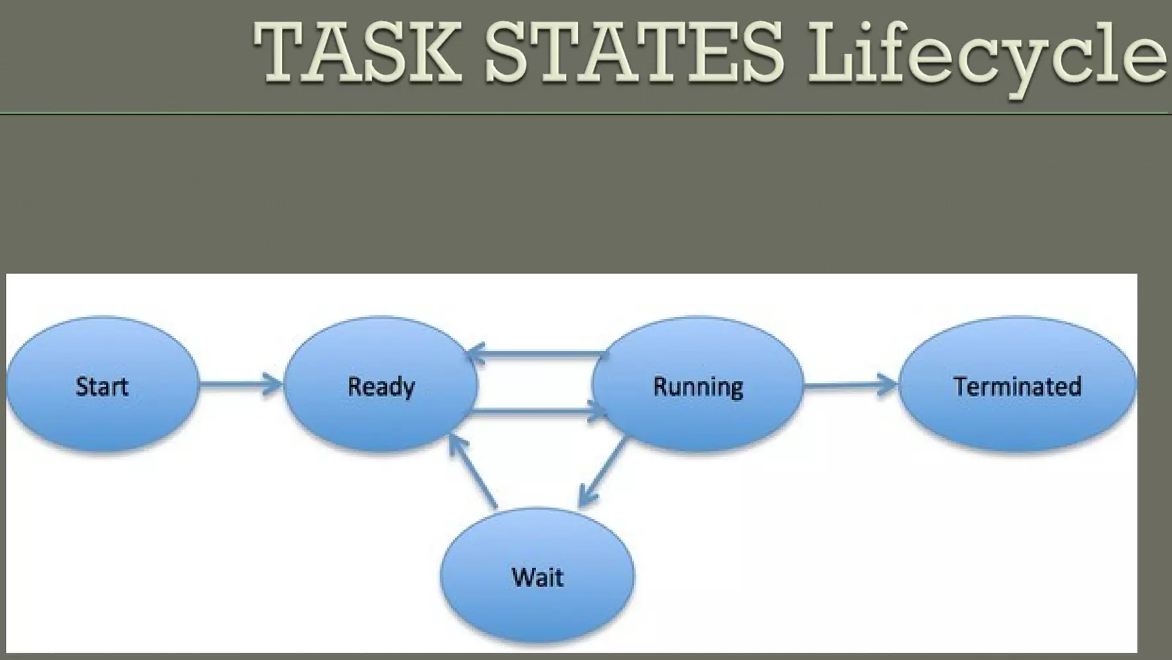
Real-time Operating System Cont..
Basic Functions of RTOS Cont.. (Task Management)
In Real Time application, any process which takes a specified execution time and occupies predefined amount of memory is called as a Task. Task Management is the process of managing tasks through its life cycle.
Each task/process can belong to one and only one state.
The Scheduler only operates on the processes in the Ready state.
Transitions to and from the Ready queue are based on the availability of the resources or the time resource available.
Typical Task Operations are-
Creating and deleting tasks
Controlling task scheduling
Obtaining task information.
Task Management provides the following information about tasks –
Number of Tasks
Resource Requirements
Release Time
Execution Time
Deadlines.

Slide 5
Real-time Operating System Cont..
Basic Functions of RTOS Cont.. (Scheduling)
RTOS Scheduler uses scheduling algorithms to organize the task on the basis of information provided by the Task Management.
The scheduling algorithms are -
Clock Driven Scheduling
Round Robin Scheduling
Priority Scheduling
Clock Driven Scheduling
Release time/execution time/deadline will be known well in advance.
Schedule can be computed at some regular time instances.
Minimal runtime overhead but it might not be suitable for all application
Round Robin Scheduling
Jobs are scheduled in FIFO manner
Time quantum given to tasks in not based on priority.
Not suitable for precedence constrained jobs (looping statements)
Job A can run only after job B.
No point in giving time quantum to Job B before job A.
Priority Scheduling
Processor is never left idle when there are ready tasks.
Processor will be allocated to processes according to priorities.
Priorities can be decided either:
Static- at design time
Dynamic- at runtime.

Slide 6
Real-time Operating System Cont..
Basic Functions of RTOS Cont.. (Resource Allocation)
We know that embedded systems have limited amount of resources in terms of memory & CPU power.
So, it is essential to allocate the available resources efficiently.
The same algorithms used for scheduling are again used for resource allocation.
Basic Functions of RTOS Cont.. (Interrupt Handling)
Interrupt is any external control signal which disturbs the normal execution of a system.
Interrupts cause the processor to suspend all other operations whatever it is doing & instead execute the code that will respond to the event which caused the interrupt.
Interrupt Service Routine (ISR) is a specialized function that executes when an interrupt occurs.

Slide 7
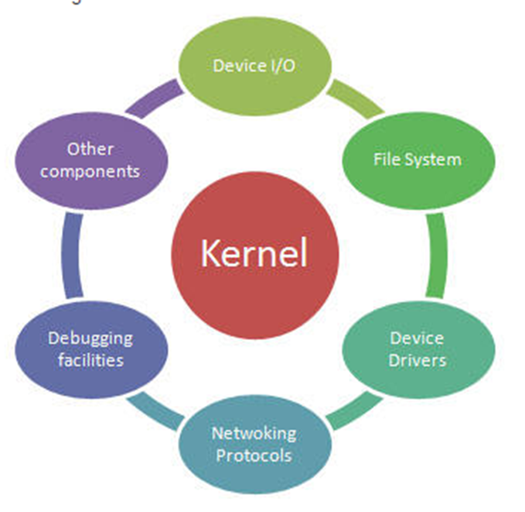
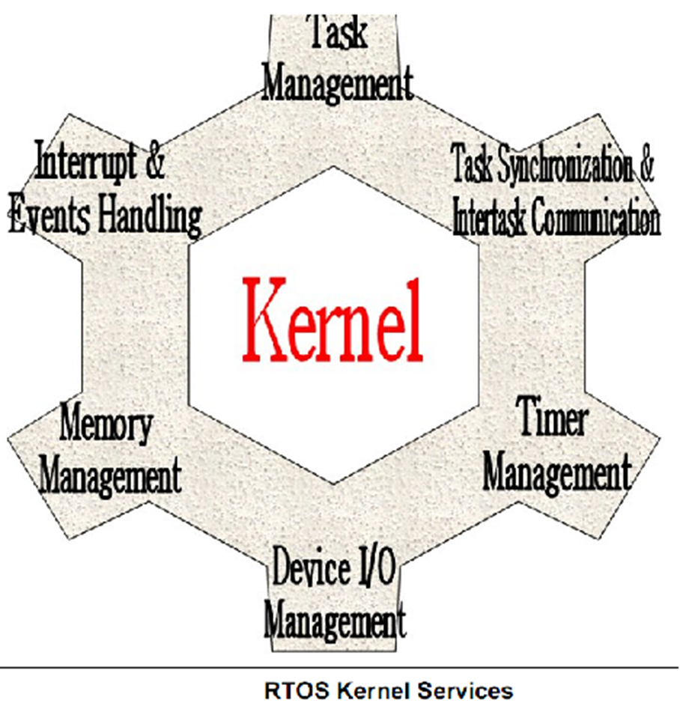
Real-time Operating System Cont..
RTOS Architecture
Usually RTOS is just a kernel but for complex system it includes modules like
Networking protocol
Stacks debugging facilities
I/Os devices
Kernel acts as an abstraction layer between the hardware and the application.
The Kernel provides
An interrupt handler
Task scheduler
Resource sharing flags
Memory management.

Slide 8
Real-time Operating System Cont..
Application of RTOS
Real- time operation systems are used in Military, Engineering Application and Data communication systems.
Automated Missiles and space satellites are also powered by RTOS these days.
In general, any embedded system application which requires immediate real-time action uses RTOS.
Features of RTOS
Occupies very less space
Response time is predictable.
It consumes some of the resources.
RTOS kernel restores the state of task and passes control of CPU for the that task.

Slide 9
General and Specific microprocessors
General- Purpose Microprocessor
Processor designed for a variety of computation tasks.
Low unit cost, in part because manufacturer spreads NRE over large numbers of units.
NRE- Non-Recurring Engineering is one-time cost of designing, developing and testing a new product or product enhancement.
Carefully designed since higher NRE is acceptable.
Can yield good performance, size and power.
Low NRE cost, sort time to market/ prototype, high flexibility
User just writes software; no processor design.
Specific Microprocessors
Designed for specific task.
Single Purpose microprocessor – it is a digital circuit designed to execute exactly one program. It contains only the components needed to execute a single program. It doesn’t have program memory. It is fast, small in size and consumes low power.
Application- Specific microprocessor – It is programable processor optimized for a particular class of applications having common characteristics. It is between of General purpose microprocessor and Single purpose microprocessor. It has program memory and special functional units. It has some flexibility, good in performance, smaller in size and has low power consumption.

Slide 10
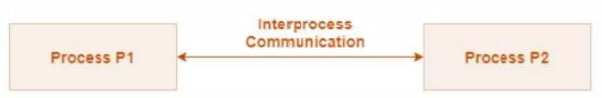
Inter Process Communication
Inter- process communication is the mechanism provided by the operating system that allows processes to communicate with each other.
This communication could be involve a process letting another process know that some event has occurred or the transferring of data from one process to another.
In RTOS there are several Kernel objects are available for synchronization and Communication. Such Kernel objects are-
Semaphores, Massage queue, Signal, Event Registers and so on.
Semaphores
A semaphore is a kernel object that one or more tasks can acquire or release for:
Mutual exclusion- it is also called Mutex. It is a locking mechanism allows to access only one process in critical section at a time.
Signalling the occurrence of an event
Synchronizing activities among tasks.
Semaphores have an associate semaphore control block (SCB), A unique ID, A user assigned value (binary or a count), and A task- waiting list.
It has two types-
Binary semaphores - It strictly provides mutual exclusion i.e. only one process in the critical section. It have only two value 0 and 1.
Counting semaphore – when we need to execute more than one process in critical section at the same. The value of counting semaphore at any point of time indicates that the maximum number of processes that can enter the critical section at the same time.

Slide 11
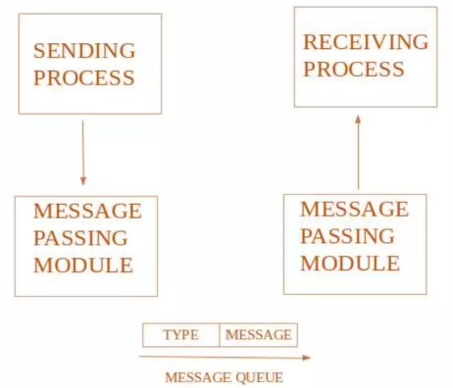
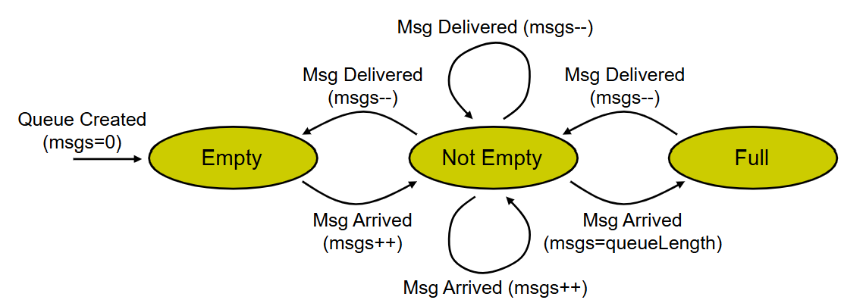
Inter Process Communication Cont.…
Massage queue
A massage queue is a linked list of massages stored within the kernel.
It is identified by a massage queue identifier.
This method offers communication between single or multiple processes with full – duplex capacity.
A massage queue holds temporarily massages from a sender until the intended receiver is ready to read them.
Massage queues are quite useful for inter process communication and are use by most operating systems.
Massage queue status
The massage queue is operated by means of an Finite Sate Machine (FSM) with three states.
If queue is full, the sending task will not be successful and has to wait before sending its message (sending task waiting list).
If the queue is empty, the receiving task has to wait for its messages (receiving task waiting list).

Slide 12
Real-time Task Scheduling
The task scheduling in a real-time operating system is the process of determining which task should be executed next. Based on the system’s resources and the task’s priorities and deadlines.
RTOS task scheduling is critical for ensuring that real-time tasks meet their deadlines.
There are two approaches to categorize scheduling algorithm-
Primary Approach.
Fundamental Approach.
Primary Approach – It refer to how scheduling is structured and designed based on task predictability and system requirement. There is mainly two types-
Static Scheduling Algorithms – Scheduling decisions are made during system design or compilation and do not change at runtime.
Rate Monotonic Scheduling (RMS) : Tasks are assigned fixed priorities based on their period.
Cyclic Scheduling : Tasks are executed in a predefined cycle. E.g. T1, T2,T3,T1,T2, T3 (repeat)
Dynamic Scheduling Algorithm – Scheduling decisions are made at runtime based on the current system state.
Earliest Deadline First (EDF) : Tasks are dynamically prioritized based on their deadlines. Task with nearest deadline gets the highest priority.
Least Laxity First (LLF) : Tasks are prioritized based on slack time. The task with the smallest laxity is given the highest priority and is executed next. Laxity=Deadline−(Current Time+Remaining Execution Time).

Slide 13
Real-time Task Scheduling Cont…
Fundamental Approach – It define how tasks are executed, prioritized, and preempted. It is two types as well.
Preemptive Scheduling Algorithm – It allow the RTOS to interrupt a running task and switch to a higher-priority task. This is important for ensuring that critical tasks meet their deadlines, even if lower-priority tasks are already running.
Preemptive Rate Monotonic Scheduling : Some priority assignment as RMS but allows preemption.
Preemptive Earliest Deadline First : Dynamically assigns priorities and allows preemption when a task with and earlier deadline arrives.
Non-Preemptive Scheduling Algorithm – It doesn’t allow the RTOS to interrupt a running task. This can be useful for tasks that need to run to completion without being interrupted, but it can also lead to missed deadlines for higher-priority tasks if a lower-priority task takes a long time to complete.
Non – Preemptive First Come First Serve : Executes tasks in the order of arrival.
Non – Preemptive Earliest Deadline First : Tasks are executed in deadline order, but a running task is not interrupted.

Slide 14
Dynamic Allocation of tasks
A mechanism to assign tasks to processors dynamically based on real-time parameters such as priority, deadline , or load. It handle varying workloads and priorities, optimize recourse utilization and improve system responsiveness and meet real- time constraints.
Techniques for Dynamic Task Allocation
Priority- Based Scheduling – Tasks are dynamically assigned based on priority.
Load balancing – Distributing tasks evenly across multiple cores or processors.
Deadline- Driven Scheduling – Allocate tasks dynamically based on deadline constraints.
Event – Driven Allocation – Tasks are activated and allocated based on external or internal events.
Challenges in Dynamic Allocation
Overhead – Increased CPU time for runtime decision- making.
Synchronization Issues – Contention for shared resources.
Latency – Potential delays in task switching or allocation.
Scalability – Complexity increases with the number of tasks or cores.

Slide 15
Multi-tasking and Concurrency issue
Multitasking allows multiple tasks to execute seemingly simultaneously by sharing CPU time. Concurrency arises when multiple tasks are in progress at the same time, potentially accessing shared resources.
Concurrency Issues – Concurrency introduces potential problems when tasks interact or share resources. Common issues include -
Race Conditions – Incorrect behaviour caused by the unpredictable order of task execution. E.g. Two tasks updating the same variable concurrently.
Deadlocks – a situation where tasks are waiting on each other indefinitely, preventing progress. E.g. Task A holds Resource 1 and waits for Resource 2, while Task B holds Resource 2 and waits for Resource 1.
Priority Inversion – A higher –priority task is blocked because a lower –priority task holds as needed resource. E.g. a low – priority task holds a mutex required by a high – priority task, while a medium – priority task preempts both.
Starvation – A task is perpetually delayed because higher – priority tasks monopolize the CPU.
Resource Contention – Multiple tasks compete for limited resource like memory, CPU or I/O
Synchronization Problems – Incorrect handling of shared data leads to inconsistencies. E.g. Updating shared data without protecting critical sections.

Slide 16
Handling Resource sharing and Task Dependencies
Resource Sharing : Multiple tasks access and modify shared resources. E.g., Memory, I/O devices, peripherals.
Task Dependencies : Tasks often depend on the completion of other tasks to proceed e.g. task B waits for task A to finish processing.
Strategies for Handling Resource Sharing and Dependencies
Mutual Exclusion – It ensure that only one task at a time accesses a critical shared resource.
Task Synchronization – Synchronize tasks in order to handle dependencies between them.
Avoiding Deadlocks
Avoiding Priority Inversion

Slide 17
Faul-tolerance
It refers to a system’s ability to continue operating correctly even in the presence of faults or failures. In real-time systems, where correctness often includes timeliness, fault tolerance is crucial for ensuring system reliability and availability.
Fault Tolerance Techniques
To achieve fault tolerance, systems use the following strategies –
Fault Detection – Identify when a fault occurs.
Techniques:
Watchdog Timers : Monitor tasks or system components for unresponsiveness
Heartbeat Mechanisms : Regular signals sent between components to indicate normal operation.
Checksums/Parity Checks : Detect data corruption in memory or communication.
Exception Handling : Handle runtime errors or unexpected behavior.
Fault Recovery – Restore system functionality after detecting a fault.
Techniques :
Retry Mechanisms : Retry failed operations, often used for transient faults.
Graceful Degradation : Continue operating in a reduced capacity
Rebooting : Restart the faulty component or system
State Rollback : Revert to the last known good state.

Slide 18
Faul-tolerance Cont…
Fault Masking – Hide the effects of faults from the system or user.
Techniques :
Hardware Redundancy : Use duplicate components.
Software Redundance : Implement diverse algorithms or backup software.
Data Redundancy : Store multiple copies of critical data.
Fault Prevention – Minimize the likelihood of faults occurring.
Techniques:
Robust Design : Use high-quality hardware and well – tested software.
Environmental Controls : Shield systems from temperature, EMI, or power fluctuations.
Regular Maintenance : Prevent hardware failures by timely repairs and replacements.
Fault Isolation – Contain faults to prevent them from propagating.
Techniques:
Partitioning : Isolate system components to ensure faults in one component do not affect others.
Firewalls and Filters : Prevent faulty inputs or data from spreading.
Circuit Breakers : Disconnect faulty hardware to protect the rest of the system.

Slide 19
Synchronization techniques
In real- time systems, synchronization ensures coordinated access to shared resources and proper sequencing of tasks or threads to prevent race conditions, deadlocks, and priority inversion.
Common Synchronization Techniques
Mutex (Mutual Exclusion) – A binary synchronization primitive that allows only one task to access a resource at a time. It prevent race conditions.
Semaphores – Binary and Counting Semaphore.
Event Flags – Used to signal task state changes or events. Tasks can wait for one or more flags to be set.
Queues – Provides synchronized communication between tasks.
Spinlocks – Busy- waiting mechanism for short –term synchronization. Suitable for multicore systems where a task cannot block.
Barriers – Synchronize multiple tasks to ensure all reach a specific point before proceeding. Common in parallel computing.
Critical Sections – Prevent preemption during the execution of critical code. Suitable for very short operations.

Slide 20
THANK YOU VERY MUCH chapter 3 Completed

